Slide 1
Building a Data Culture with Power BI Romania Power BI and Modern Excel User Group October 27, 2022
Matthew Roche
Principal Program Manager Microsoft
@SQLAllFather | https://ssbipolar.com/

Slide 2
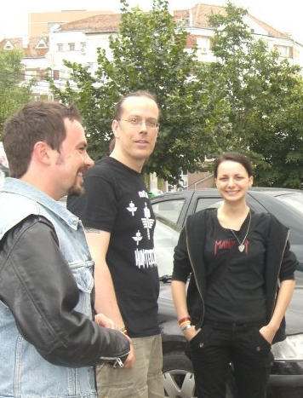

Matthew Roche
Today: Working with the world’s biggest companies to help them adopt, implement, and improve Power BI.
Yesterday: Building and shipping products and services for data governance, data management, ETL, and BI.
Forever ago: Training, mentoring, and consulting with companies of all sizes as a data architect and technical lead.

Slide 3
A brief history of business intelligence

Slide 4







A brief history of business intelligence
Self-Service BI
OLTP systems
Data Warehouse
Reports and dashboards
Data Lake
Data Preparation / ETL
OLAP / Analytics Models

Slide 5
From Business Intelligence to Data Culture

Slide 6
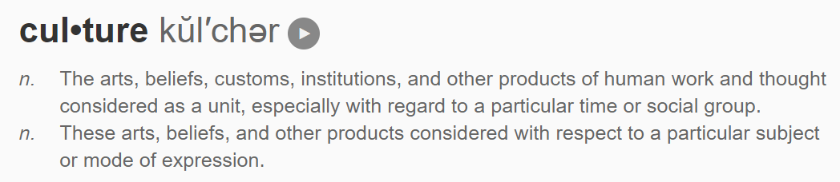
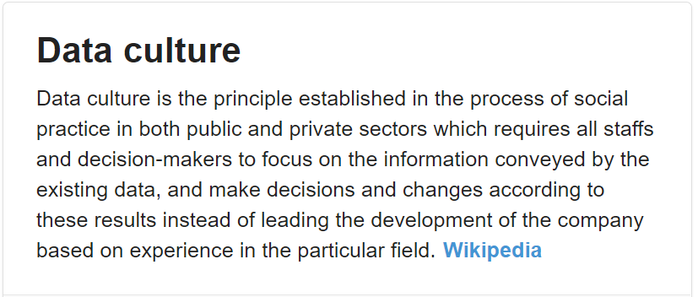
Notes:
Screen shots from https://duckduckgo.com/?q=define%3A+culture&ia=definition and https://duckduckgo.com/?q=define+%22data+culture%22&ia=web

Slide 7



Notes:
Screen shots from https://duckduckgo.com/?q=define%3A+culture&ia=definition and https://duckduckgo.com/?q=define+%22data+culture%22&ia=web

Slide 8
Imagine a world where…
Making decisions based on common trusted data is the norm
Business users have access to the tools, data, and insights they need
Business users are part of a supported and valued community of practice where guidance and assistance are readily available
Business users are recognized and rewarded for their contributions
IT teams focus on architecture, scale, and complex strategic investments
Data governance is applied in ways that enable business users to work efficiently within the system, not outside it
IT and business work in true partnership to achieve shared organizational goals

Slide 9
Top Tip: Executive sponsorship

Slide 10

Without an executive sponsor, you will fail

Slide 11
Without an executive sponsor, you will fail

Slide 12

Executive sponsorship
The scope of a data culture is typically defined by the authority of its executive sponsor.
Building a data culture is like running a marathon. Lacking executive sponsorship is like running a marathon in sand: everything is much harder than it needs to be, no one wants to sign up, and the whole thing typically ends with disappointment for the people who tried the hardest.

Slide 13
Building a data culture: The easy part
Notes:
The easy part is technology

Slide 14
TIGHTER CONTROLS
EDW
Permanent record
Subject to compliance
Push down content
Reporting services
BUSINESS UNIT
DASHBOARDS, KPIS & SCORECARDS
IT-developed and maintained
Consistent criteria and responsibilities
Push up content
Power BI Desktop
Excel or other reports
Business developed and maintained
Knowledge management
Information sharing
DEPARTMENTAL, TEAM OR GROUP REPORTING
PROJECT REPORTING
Personal/Private views
Data science exploration
PERSONAL REPORTING
LOOSER CONTROLS

Slide 15
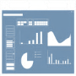

Corporate culture drove….
…challenges in reporting/analytics...
...which led to a new BI Strategy
Inconsistent
Definitions, hierarchies, metrics & KPIs
Flexibility at the Edge
Finance has agility
Self Service BI
!!% analyst time spent collecting & compiling data
Discipline at the Core
IT Retains Control
Encourages individuals to pursue full ownership
Strong cultural resistance to doing things in a standard way
!!% reports created in “offline environments”
Single Master Data Source
!!!+ decentralized Finance Tools and Systems
Standard Corporate BI
Consistent Taxonomies
~$!!! annual spend on “shadow applications”

Slide 16
Personal
Team
Departmental
Enterprise
Power BI Desktop
No Pro license
Pro license for author
Pro license for reader
Managed SSBI
Premium capacity w/gates
Central BI
Full support and ALM
No sharing

Slide 17
End Users
Any user can work with data
Curated datasets
Users in Key Departments
Any user can work with data
More data available
Power Users
More skills
More tools
Better resources
Hardcore IT
Professional developers
Traditional owners of BI
Exploration
Promotion
Preparation
Operationalization
Gateway
Data sources
Prod workspace
Work with SSBI
Documentation
Ownership
Full support
Prove out ideas
Desktop or Excel
Scheduled refresh
Theme
SLA
Well-defined requirements for each phase

Slide 18
Exploration
Promotion
Preparation
Operationalization
Gateway
Data sources
Prod workspace
Work with SSBI
Documentation
Ownership
Full support
Prove out ideas
Desktop or Excel
Scheduled refresh
Theme
SLA
Well-defined requirements for each phase
End Users
Any user can work with data
Curated datasets
Users in Key Departments
Any user can work with data
More data available
Power Users
More skills
More tools
Better resources
Hardcore IT
Professional developers
Traditional owners of BI

Slide 19
Building a data culture: The hard part
Notes:
The hard part, like Soylent Green, is people

Slide 20


Establish a Center of Excellence or Network of Excellence
Recognize and nurture a Community of Practice
Key business and IT stakeholders
System and process owners
Decision-makers
People with budgets
People with problems
People with solutions
Champions
Moderators and stewards

Slide 21

Is this starting to feel ‘above my pay grade’?
Remember how we started off with that boring ‘executive sponsorship’ topic? Are you starting to see how that sponsorship might help here?

Slide 22
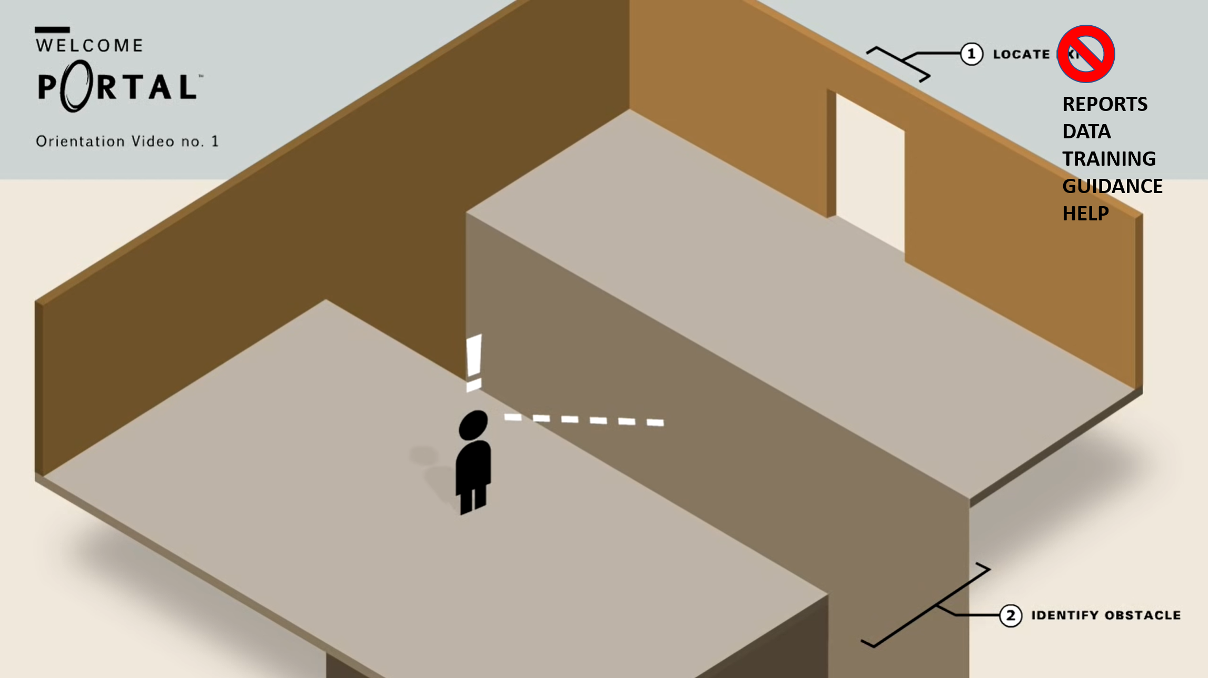
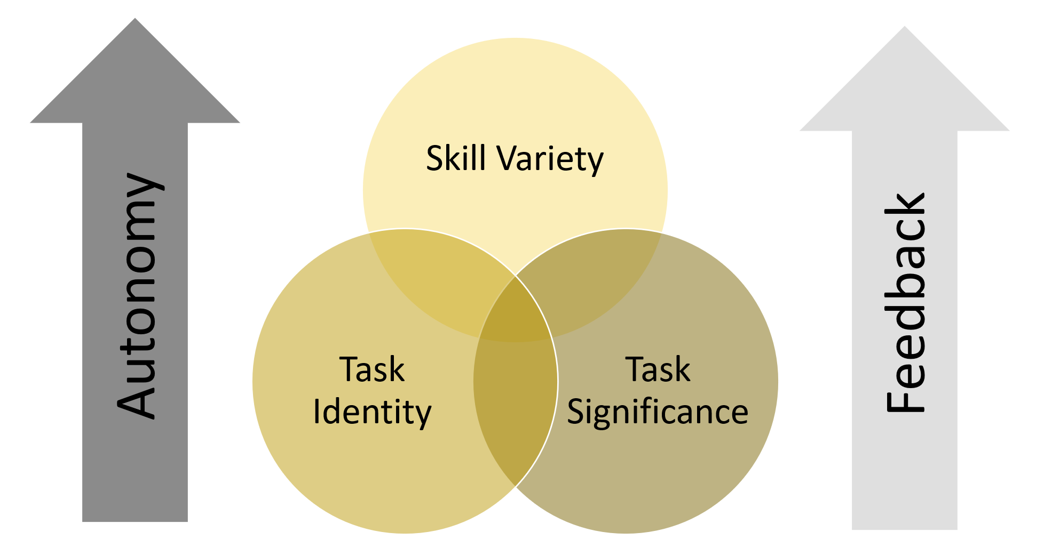
Your community needs a home
Your community members need motivation
Build portal
Consolidate resources in portal
Direct traffic to portal
Repeat
Listen and learn
Find places for people to help
Say thank you, and mean it
Repeat

Slide 23
Wrapping up

Slide 24
“A complex system that works is invariably found to have evolved from a simple system that works. The inverse proposition also appears to be true: A complex system designed from scratch never works and cannot be made to work.”
-- John Gall
Notes:
https://www.goodreads.com/quotes/9353506-a-complex-system-that-works-is-invariably-found-to-have
“A complex system that works is invariably found to have evolved from a simple system that works. The inverse proposition also appears to be true: A complex system designed from scratch never works and cannot be made to work.”
― John Gall, The Systems Bible: The Beginner's Guide to Systems Large and Small: Being the Third Edition of Systemantics

Slide 25

Strategy without tactics is the slowest route to victory. Tactics without strategy is the noise before defeat.
Sun Tzu
Notes:
https://www.davidbrim.com/sun-tzu-lessons-on-strategy/
https://www.brainyquote.com/authors/sun-tzu-quotes
https://www.goodreads.com/author/quotes/1771.Sun_Tzu

Slide 26


There is no single path to success
“All happy families are alike; each unhappy family is unhappy in its own way.”
-- Leo Tolstoy, Anna Karenina
Notes:
You have a unique starting point
You have a unique destination
You have a unique set of resources
You have a unique set of constraints
You have a unique and constantly-changing landscape to navigate
Do you have an executive sponsor?
It all comes down to culture – BI Polar (ssbipolar.com)

Slide 27
Summary and resources

Slide 28
Related content
Power BI documentation
Adoption Roadmap: https://learn.microsoft.com/en-us/power-bi/guidance/powerbi-adoption-roadmap-overview
Implementation Planning: https://learn.microsoft.com/en-us/power-bi/guidance/powerbi-implementation-planning-introduction
Guidance home: https://learn.microsoft.com/en-us/power-bi/guidance/
Matthew Roche’s blog and YouTube:
https://ssbipolar.com/building-a-data-culture/
☝ 17-video “Building a data culture” YouTube series + much more
PASS Data Community Summit pre-conference with Melissa Coates
https://aka.ms/HitchhikersGuide (paid event, Tuesday November 15, online or Seattle)
Power BI customer success stories
https://customers.microsoft.com/en-us/story/1557385809666881648-walmart-retailer-power-bi

Slide 29
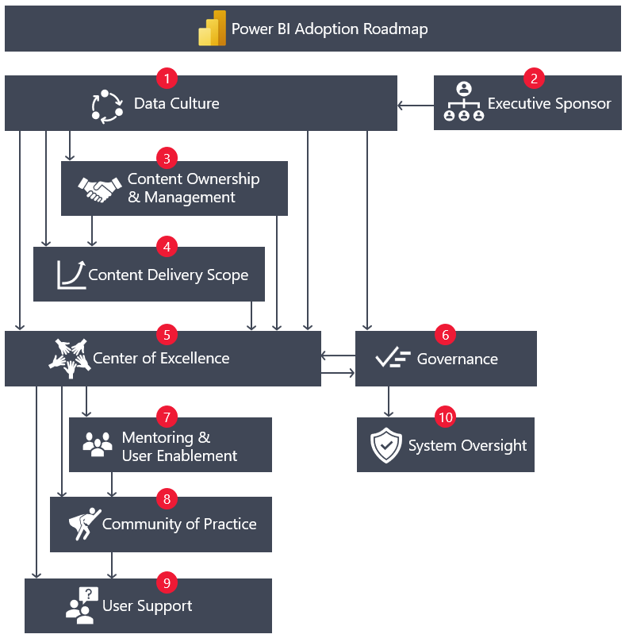
Power BI Adoption Roadmap
Contents
Data culture
Executive sponsorship
Content ownership
Content delivery scope
Center of excellence
Governance
Mentoring and user enablement
Community of practice
User support
System oversight
Consistent guidance
Concepts and context
Considerations and key actions
Maturity levels
Notes:
https://docs.microsoft.com/en-us/power-bi/guidance/powerbi-adoption-roadmap-overview

Slide 30
Q&A

Slide 31
Building a Data Culture with Power BI
Matthew Roche
Principal Program Manager Microsoft
@SQLAllFather | https://ssbipolar.com/

Slide 32
Thank you!

